Slide 1
College Library
Management System

Slide 2
1
Objective Of Project
2
Scope Of Project
Contents
3
Technologies Used
4
Screenshots

Slide 3

1
Objective Of Project

Slide 4
Objective Of Project
To develop an application that deals with the day to day requirement of any college library.
To develop the easy management of the books in the library.
To build a system that can receive input and generate automatically output in easy way
and short time.
To build a monitoring system that is able to monitor and manage all library operations
efficiently.
To give an opportunity to librarians to reduce mistakes that always happen during manual
method.
To store properly the library items in order to maintain their security.
To enter and preserve details of the various book issues and keep a track on their returns.

Slide 5
2
Scope Of Project

Slide 6
Scope Of Project
A library management system is an ERP system that is built and developed to manage all of a library's internal functions. Some of the scope are :
Only authenticated persons, i.e. the Admin or the Office Employee(s), is/are responsible
in assigning/accessing the details or records.
It is security driven.
Books can be added as per the requirement.
It will give more timely information.
It will provide an error reduction in the data handling process.
It is cost effective than manual approach.

Slide 7
3
Technologies Used

Slide 8




Technologies Used
Application Editor
Database
Database Query Language
Language Used

Slide 9
4
Screenshots

Slide 10
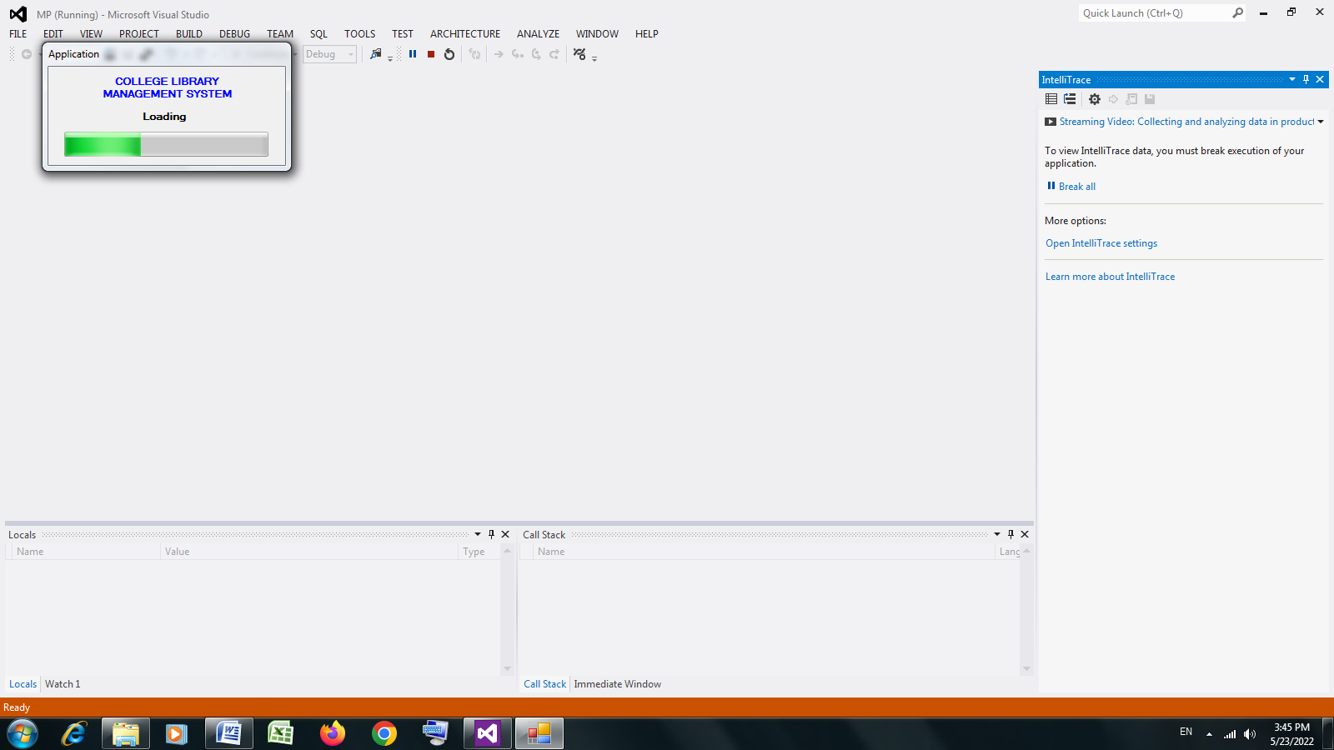
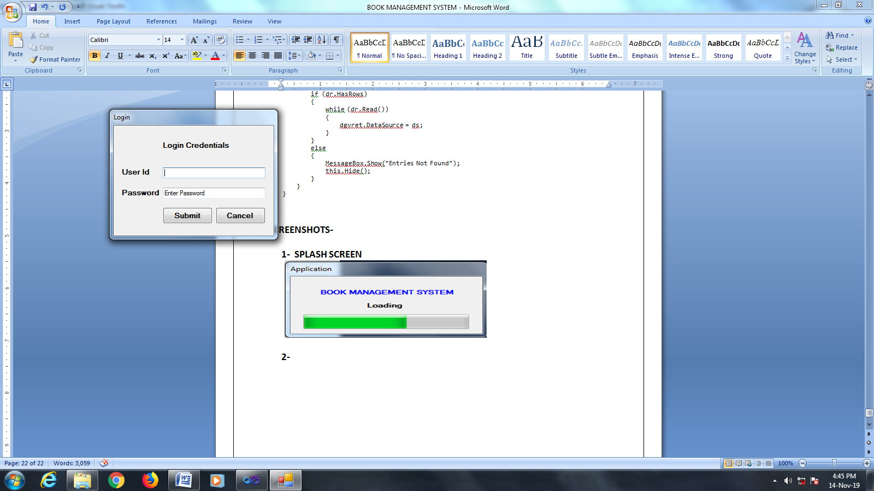
1- Splash Screen
4
Screenshots
2- Login Screen

Slide 11
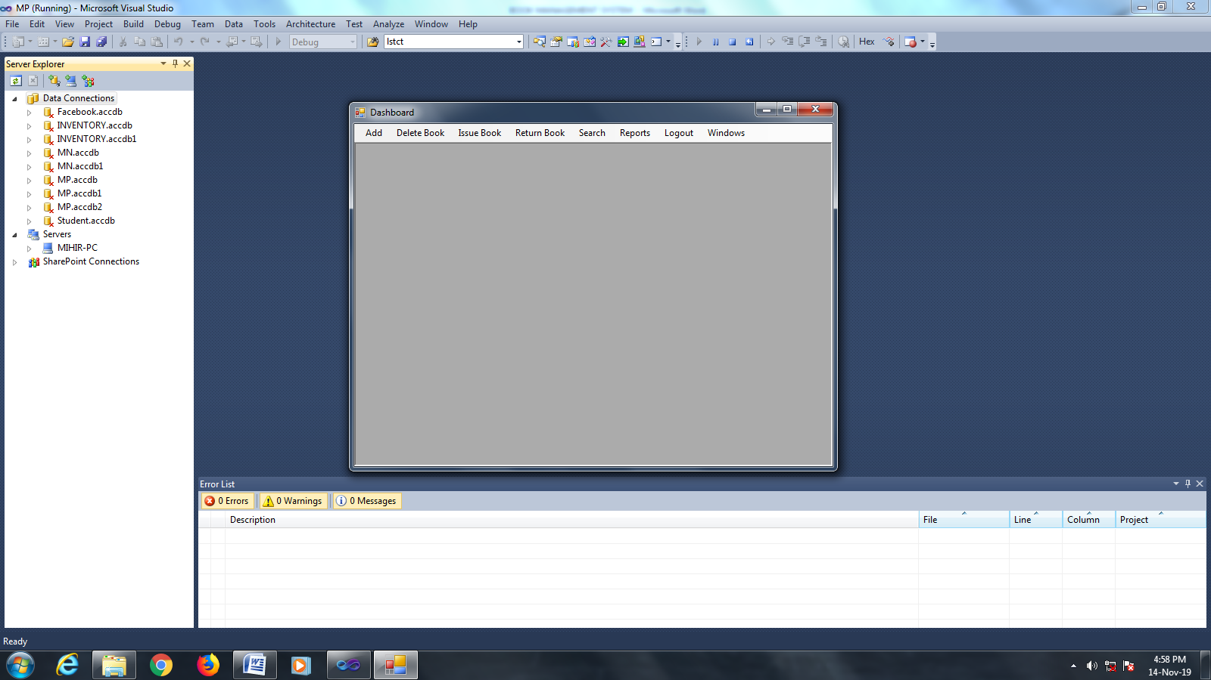
3- Dashboard
4
Screenshots

Slide 12

4- Add Book Details
4
Screenshots

Slide 13

5- Add Student Details
4
Screenshots

Slide 14

6- Delete Book
4
Screenshots

Slide 15
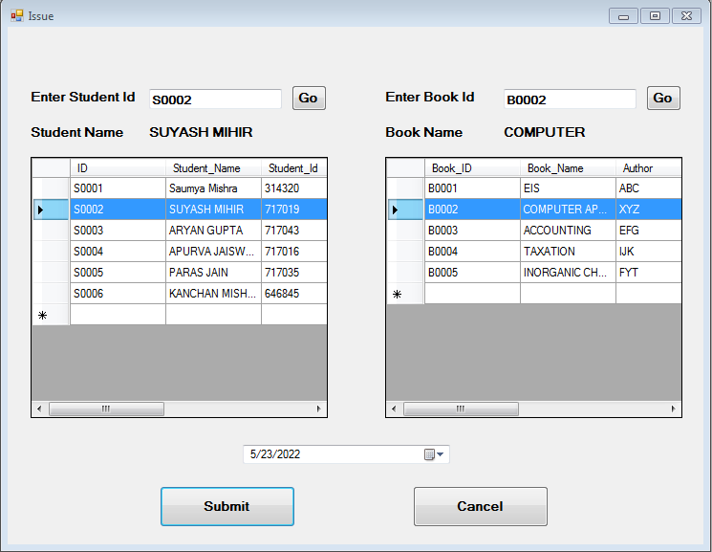
7- Issue Book
4
Screenshots

Slide 16
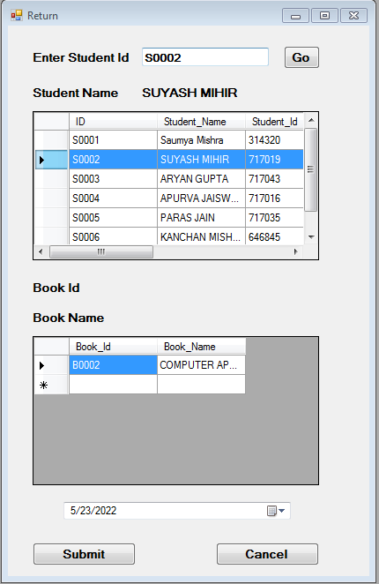
8- Return Book
4
Screenshots

Slide 17

9- Search Book Details
4
Screenshots

Slide 18

10- Search Student Details
4
Screenshots

Slide 19
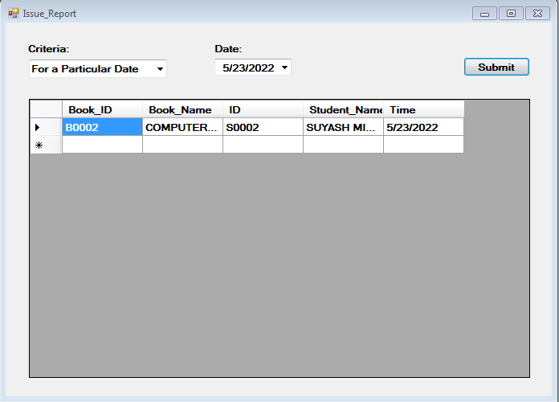
11- Issue Report Details
4
Screenshots

Slide 20
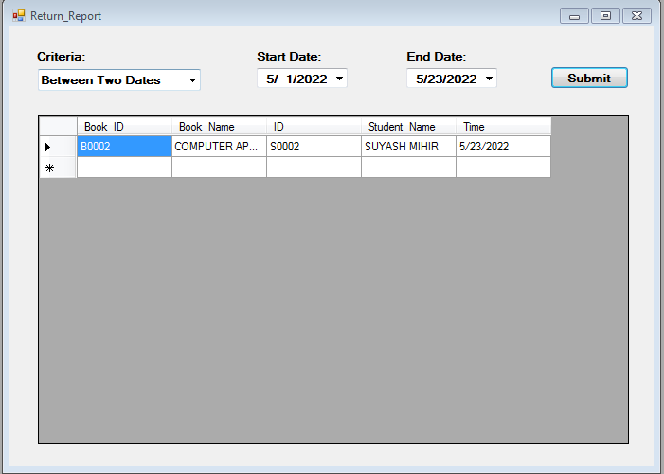
12- Return Report Details
4
Screenshots

Slide 21

Thank you!

